Slide 1
AI Symptom
Smart Health Guidance Through AI
Name: Vaibhav Badlawala B
Team: Individual
Event: Hackathon 2026

Slide 2
Problem Statement
Many people experience health symptoms but often do not know:
- 😟 whether the symptom is serious,
- ⏳ what it could mean,
- ❓ whether immediate attention is needed.
People need a simple, fast, and accessible way to get early health guidance.

Slide 3
Our Solution
AI Symptom is a mobile health assistant that allows users to enter or select their symptoms and receive instant AI-based health guidance.
The app helps users:
- understand possible health issues,
- get quick first-level health awareness,
and make better decisions about what to do next.
It acts as a smart first-step health assistant — not a replacement for a doctor, but a guide for early awareness.

Slide 4
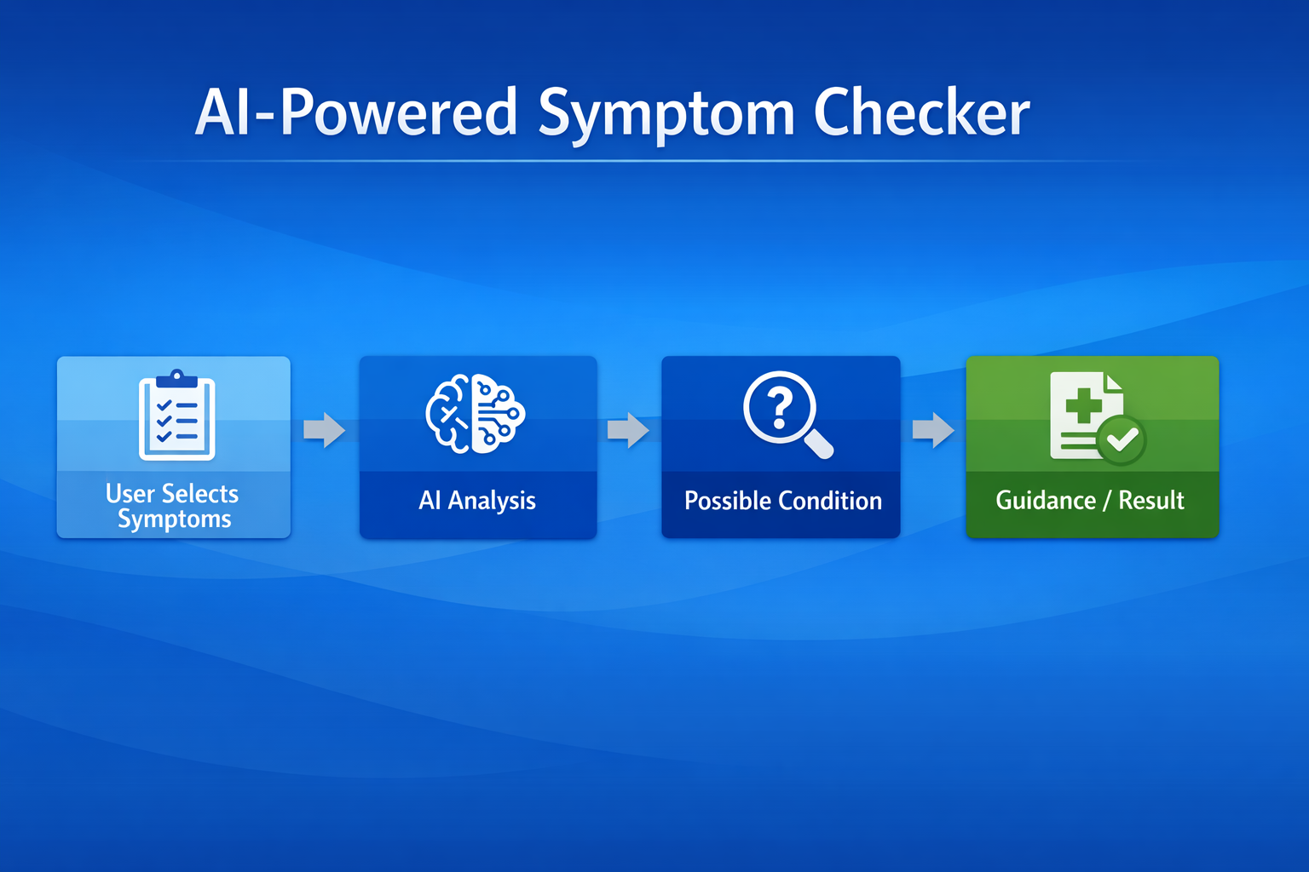

Slide 5
Key features of AI Symptom
Feature 1 — Symptom Checker
Users can select symptoms easily from the app and start a health check instantly.
Feature 2 — AI-Based Analysis
The app processes symptom input and predicts possible health conditions intelligently.
Feature 3 — Instant Result
Users receive quick health guidance without waiting.
Feature 4 — Health History
Previous symptom checks and results can be stored and reviewed.
Feature 5 — User Profile
Basic user details help personalize the experience.
Feature 6 — Clean Mobile UI
Simple, smooth, and beginner-friendly design for easy use.

Slide 6
Thank you
Download app from this link:
Android: https://drive.google.com/file/d/1StRJqpcm4Pqi6OaoU76XO4TdpYfwbrTa/view?usp=drive_link
Future Enhancements
In the future, we plan to integrate large language models (LLMs) and advanced data science techniques to make the app more interactive, smarter, and more powerful, while keeping it safe and user-friendly.
Disclaimer / Academic Purpose
This application is a prototype built for academic purposes only. It does not provide medical recommendations or replace professional health advice.

